Slide 1
Transformation

Slide 2
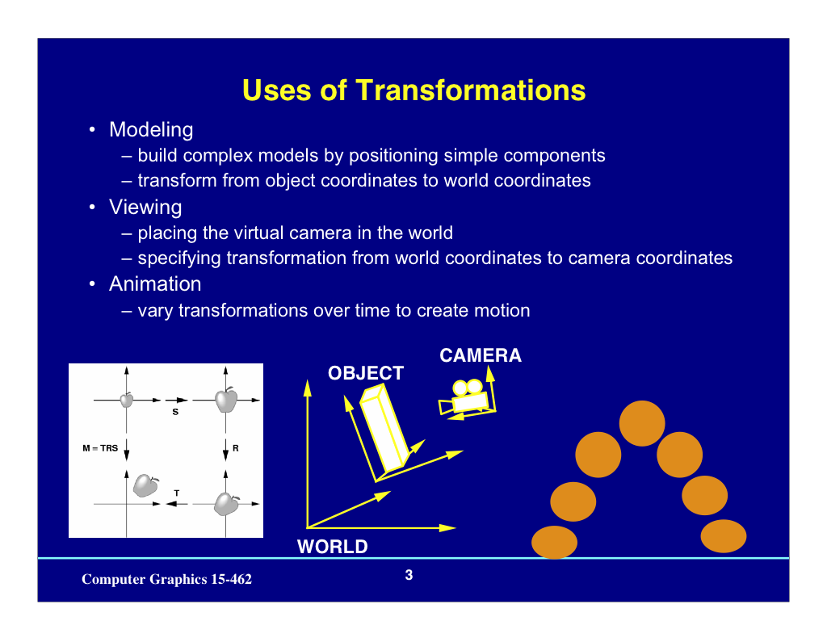

Slide 3
Types of Transformations
There are various types of transformations in computer graphics through which an image can be processed, edited and altered. Some basic and most commonly used types of these transformations are:
Translation
Rotation
Scaling
Reflection
Shearing

Slide 4
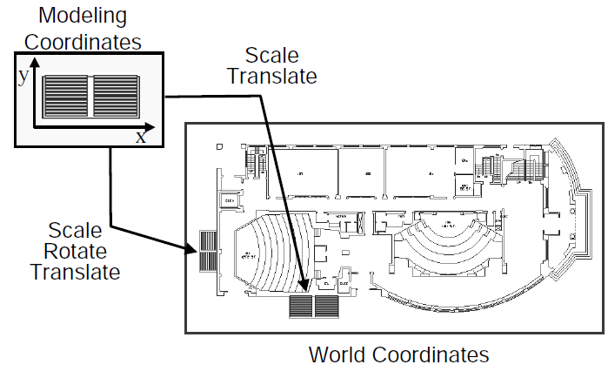
2D Modeling Transformations

Slide 5
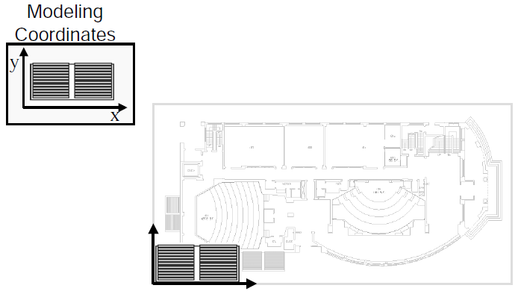
2D Modeling Transformations

Slide 6
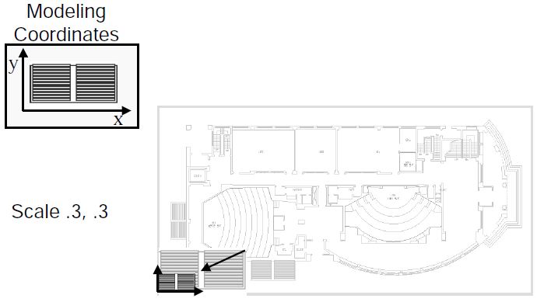
2D Modeling Transformations

Slide 7
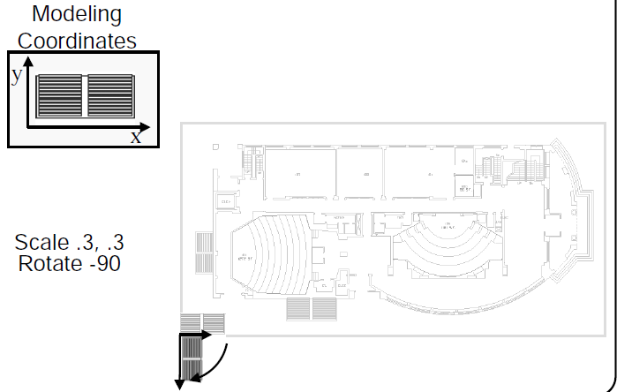
2D Modeling Transformations

Slide 8
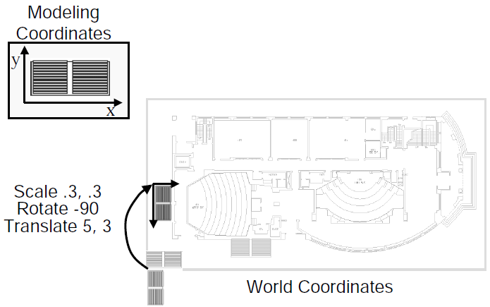
2D Modeling Transformations

Slide 9
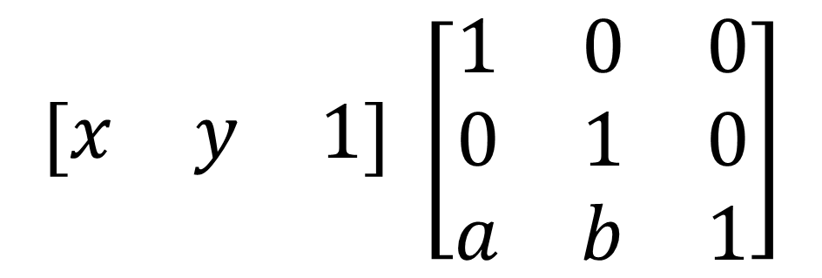

Basic 2D Transformations
Matrix Representation
Translation
$$\left[\begin{matrix}x & y & 1\end{matrix}\right] →\left[\begin{matrix}x+a & y+b & 1\end{matrix}\right]$$
$$\left[\begin{matrix}x & y & 1\end{matrix}\right] \left[\begin{matrix}1 & 0 & 0 \\ 0 & 1 & 0 \\ a & b & 1\end{matrix}\right]$$
$$→\left[\begin{matrix}x+a & y+b & 1\end{matrix}\right]$$

Slide 10
Basic 3D Transformations
Matrix Representation
3D Translation

Slide 11
Basic 3D Transformations
Matrix Representation
3D Translation

Slide 12
3D Translation

Slide 13
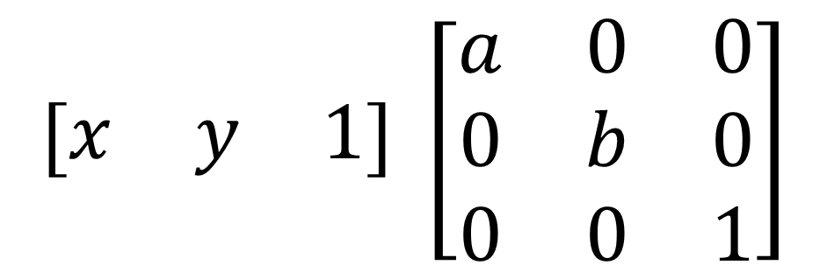

Basic 2D Transformations
Matrix Representation
Scaling
$$\left[\begin{matrix}x & y & 1\end{matrix}\right] →\left[\begin{matrix}ax & by & 1\end{matrix}\right]$$
$$\left[\begin{matrix}x & y & 1\end{matrix}\right] \left[\begin{matrix}a & 0 & 0 \\ 0 & b & 0 \\ 0 & 0 & 1\end{matrix}\right]$$
$$→\left[\begin{matrix}ax & by & 1\end{matrix}\right]$$

Slide 14
3D Scaling

Slide 15
3D Scaling

Slide 17
Uniform Scaling

Slide 19
Non-Uniform Scaling

Slide 20
Uniform Scaling about an arbitrary point
Step1 : Translate the object to the origin.
Step2 : Scale the object by given Scale factor.
Step3 : Translate the object back to the original position
These three steps can be combine with transformation matrix as below:
from right to left

Slide 22
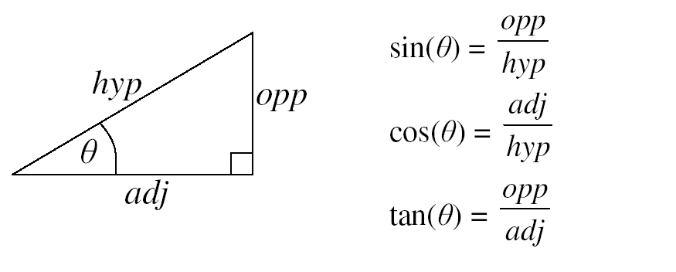

Slide 23
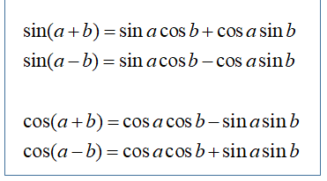

Slide 33
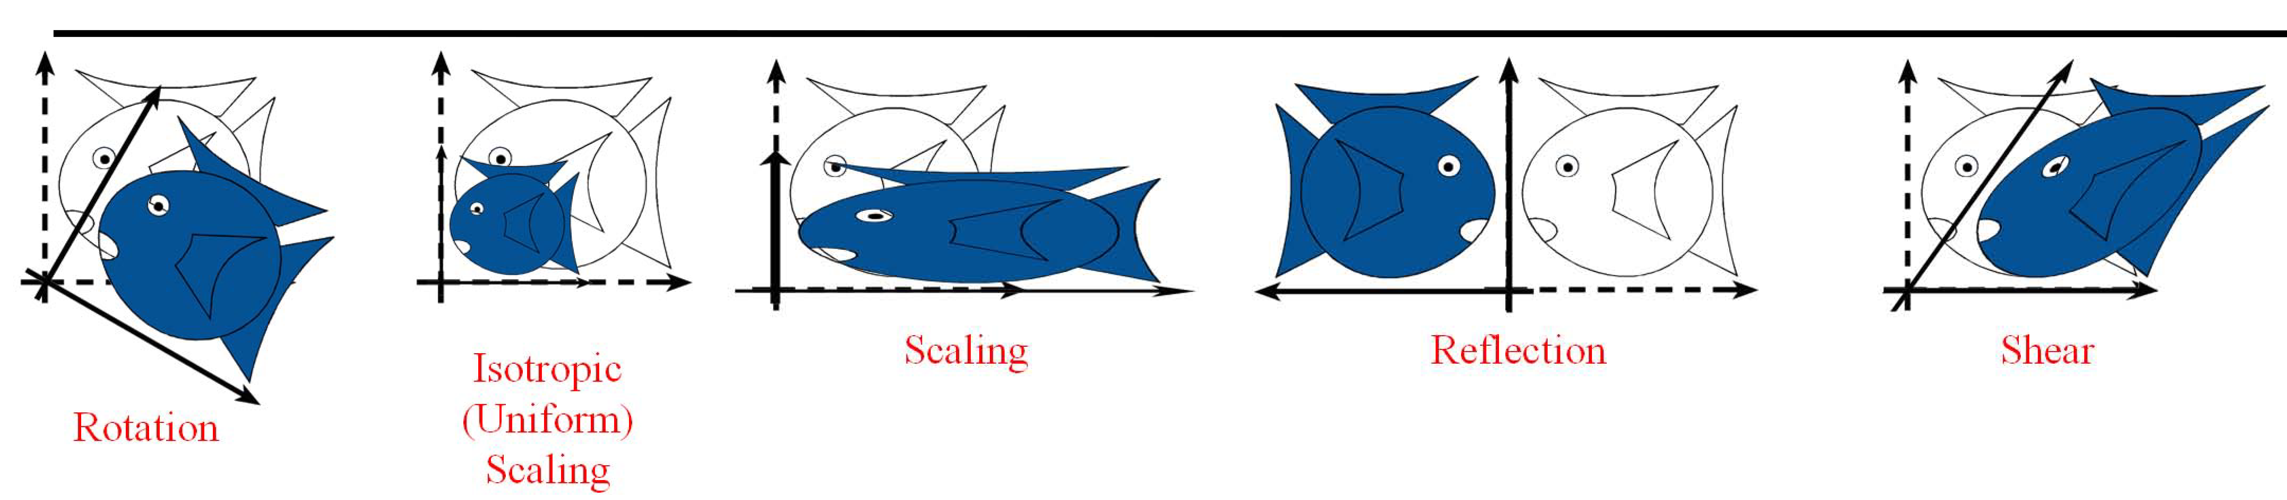
Linear Transformation

Slide 34
Points vs. Vectors
• A point is a location
• A vector is a motion between two points
• Adding vectors is meaningful
- going 3km North + 4km East = going 5km North-East
• Adding points is not meaningful
- Dhaka location + New York location = ?

Slide 35
Affine space
Points are elements of an affine space

Slide 36
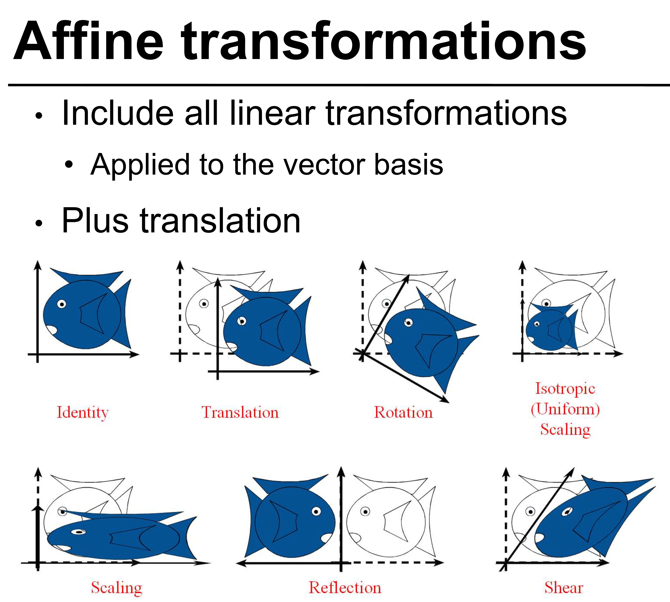

Slide 37
Frames & hierarchical modeling
Example: what if I rotate the wheel of the moving car:
• frame 1: world
• frame 2: car
• transformation: rotation
the transformation in world is A⁻¹BA
i.e., from right to left, A takes us from world to car, then we apply B (rotation), then we go back to world with A⁻¹

Slide 38
How are transforms combined?

Slide 39
Non-commutative Composition

Slide 40
